Slide 1
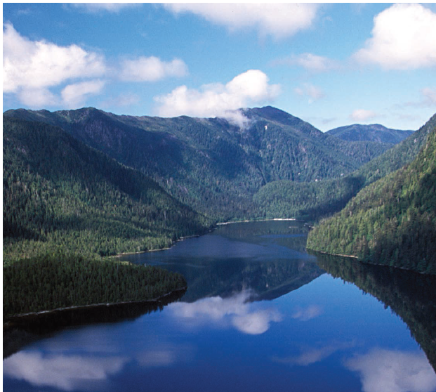
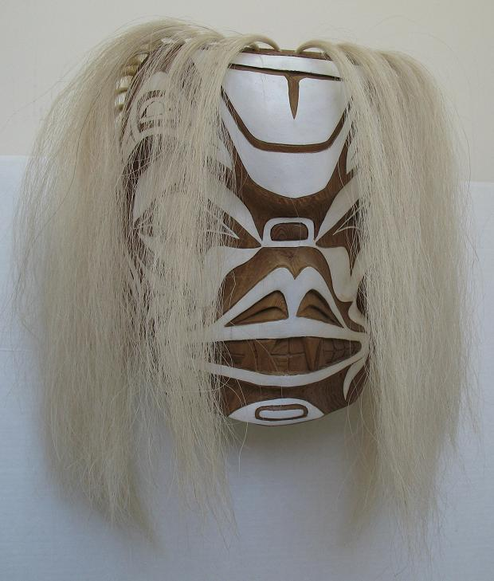
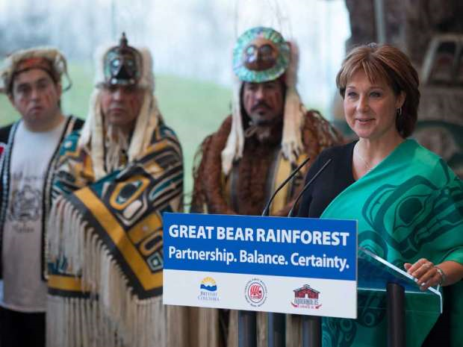
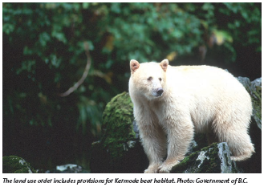
The Great Bear Rainforest

Slide 2
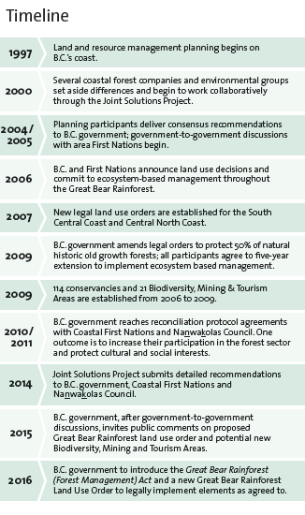

Slide 3

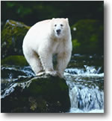
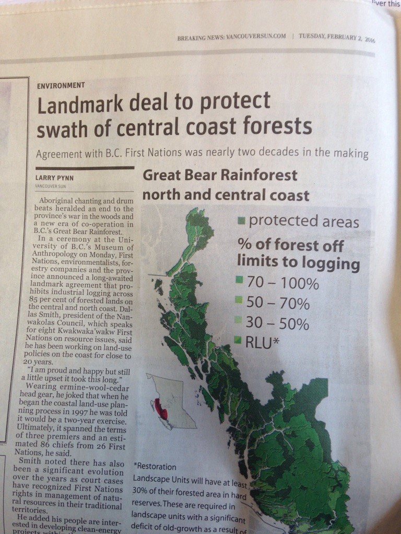
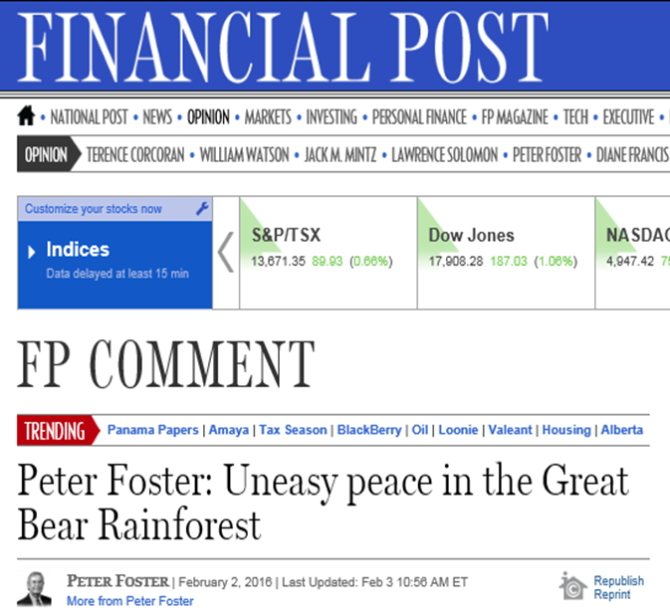
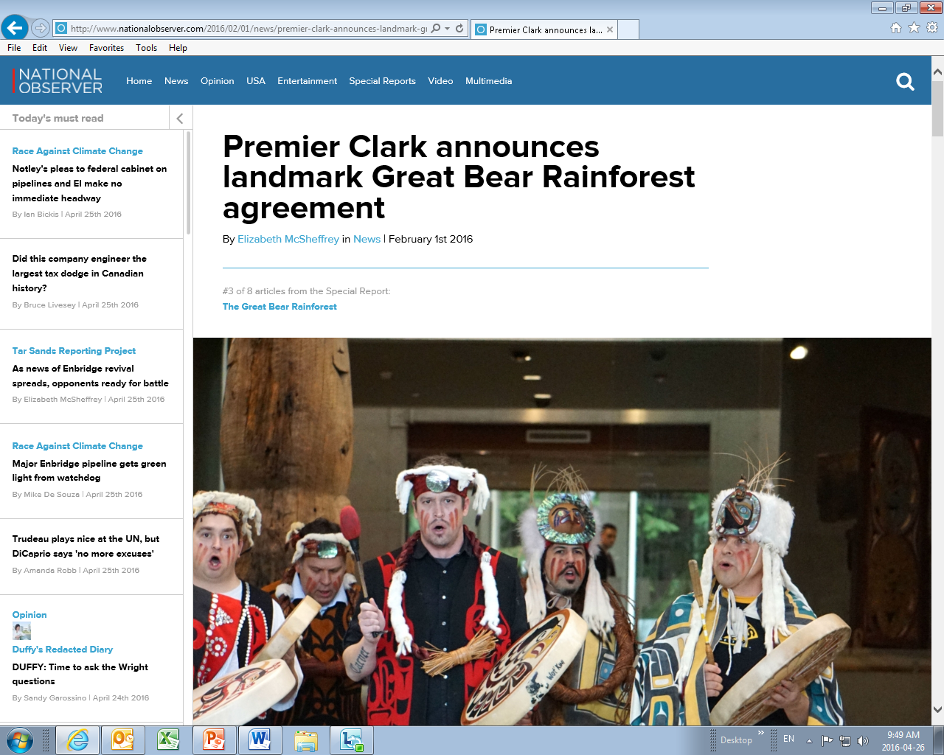
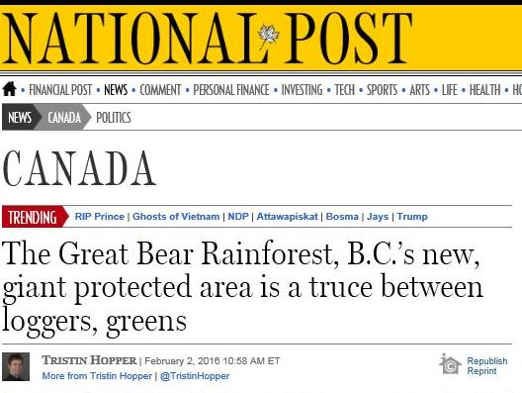
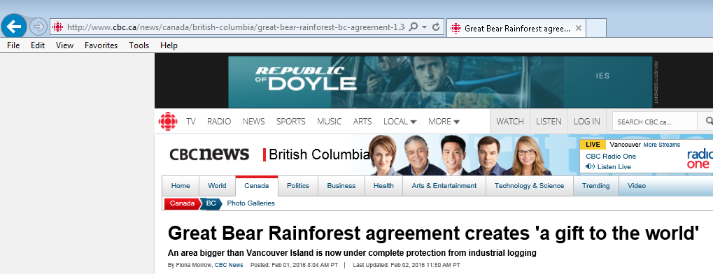
Headlines Around the World
“Its Really, Really Big”

Slide 4
Ecosystem Based Management
Land Use Order
Agreements with First Nations and Industry
GBR Forest Management Act

Slide 5
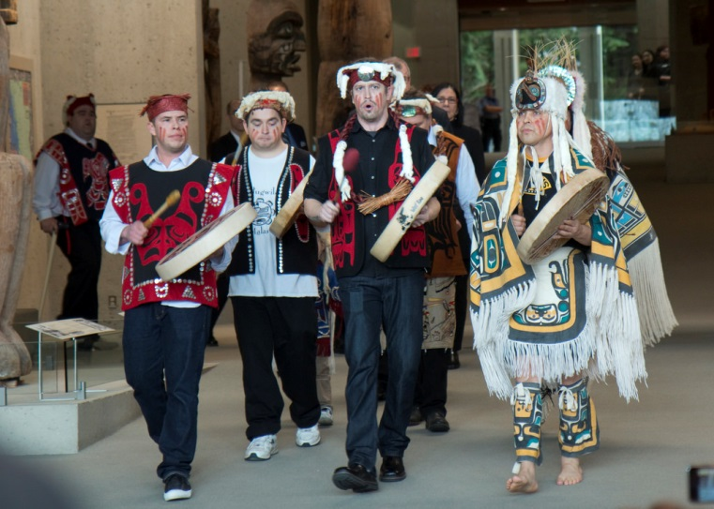
What was Achieved?
Under the new Great Bear Rainforest land-use order, ecological integrity is achieved through increasing the amount of protected old-growth forest to 70% from 50%
Eight new special forest management areas covering almost 295,000 hectares will be off-limits to logging (5 may receive additional protection based on ongoing discussions with First Nations)
With the new measures, 85% of the forest will be protected and 15% will be available for logging
The land-use order addresses First Nations Engagement, cultural resources, biodiversity, freshwater ecosystems, wildlife habitat
New are the Implementation objectives (Landscape Reserve Design, Managed Forest and
Natural Forest)

Slide 6
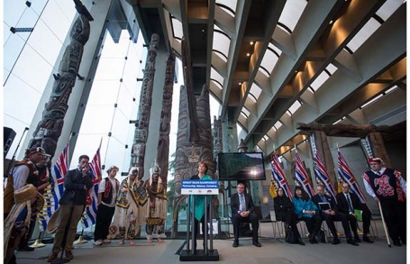
What was Achieved?
The amount of habitat protected for the marbled murrelet, northern goshawk,
grizzly bear, mountain goat and tailed frog will increase as new reserves
required by the order are developed
Through government-to-government relationships, separate human well-being agreements have been reached to address issues of special concern to each group of First Nations. Most notably, they have an increased stake in the forest sector
The commercial grizzly bear hunt will cease in Coastal First Nations traditional territories
The Province has provided additional
carbon credits from the GBR to the
Nanwakolas and Coastal First Nations.
This will increase the forest carbon
credits they can use to support
implementation of EBM and projects
of importance to them

